Slide 1
AWS Services Practical Implementation
N.V.N Sai Vardhan
20a31a05i3

Slide 2
Section 1
Creating an EC2 Instance and launching it from windows
Remote Desktop Connection

Slide 3
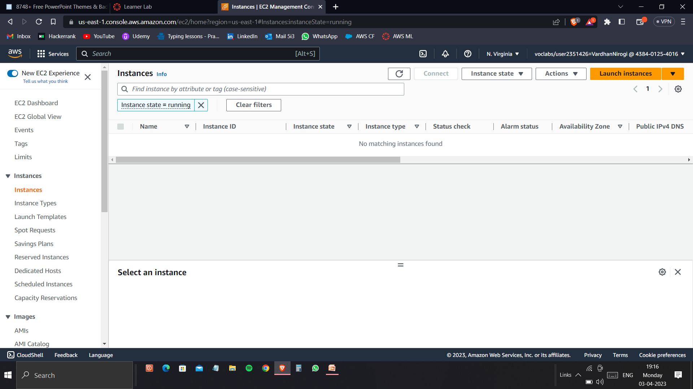
Login into AWS Learner Lab and select the EC2 instances option. Then click launch instances.

Slide 4
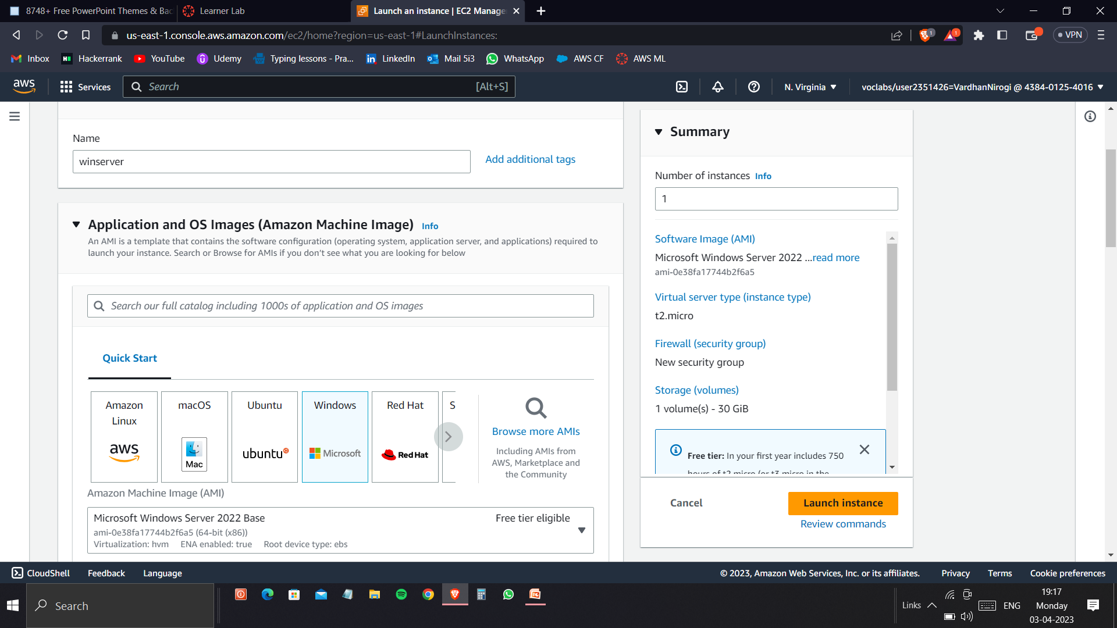
Give a name to your server and choose Windows as the Amazon Machine Image. Then launch instance.

Slide 5
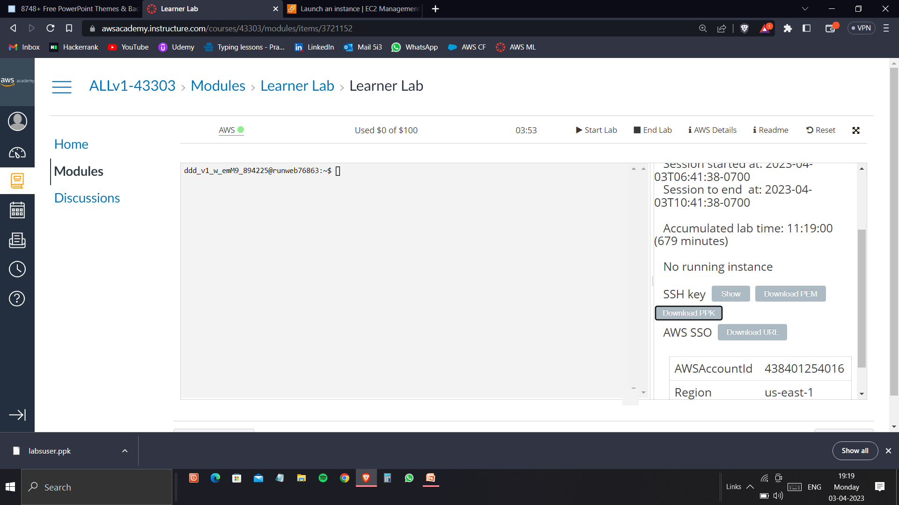
In the AWS details section, download the ssh key as .pem file format.

Slide 6
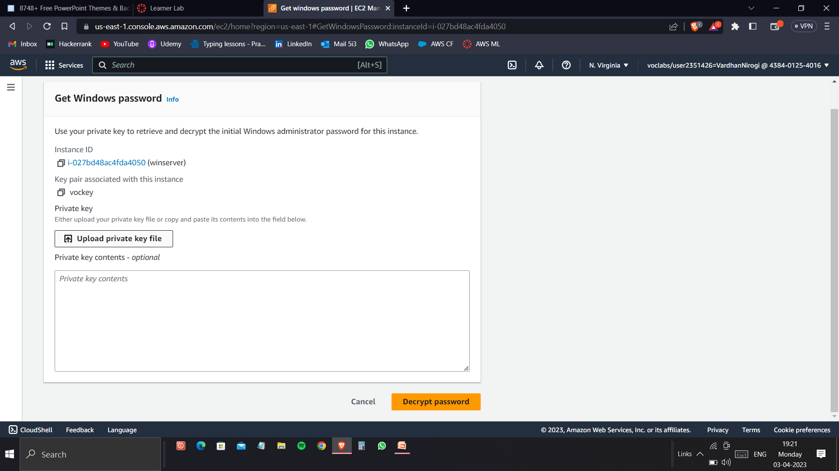
Go to Get Windows password in the actions of the EC2 instance which you want to connect. Here upload pem key.

Slide 7
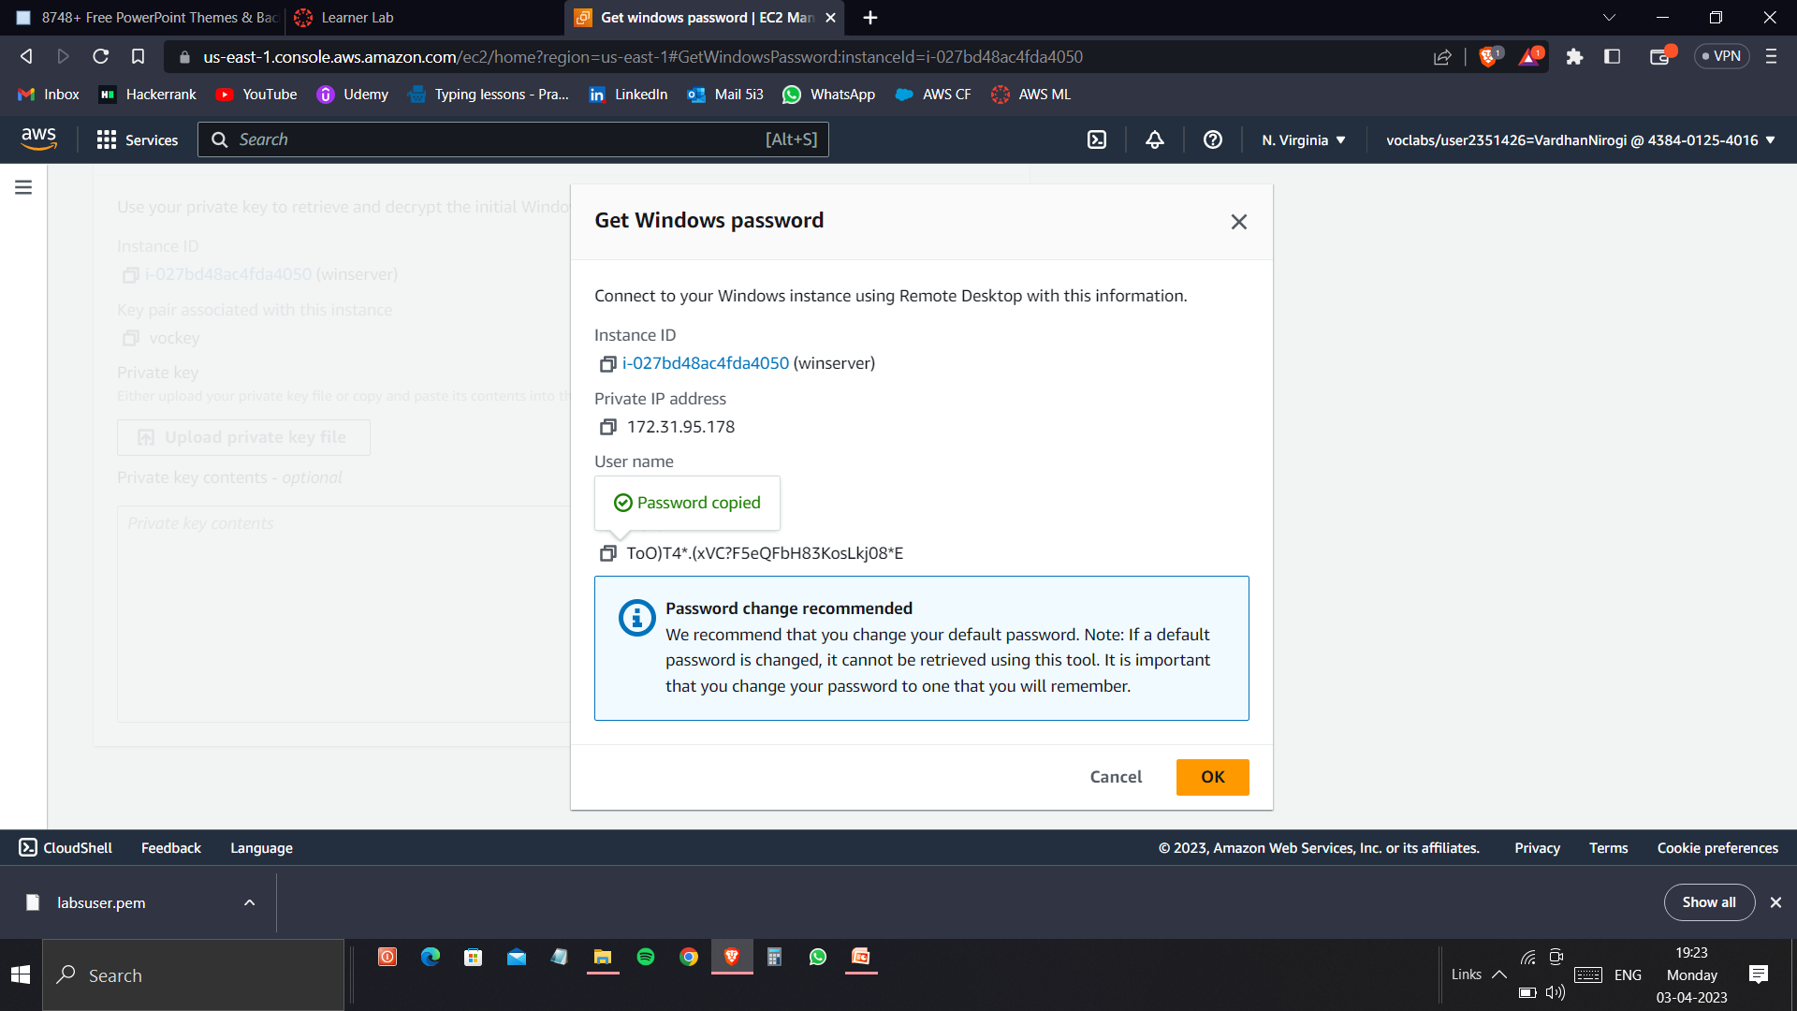
Then decrypt the password to get the password of the user Administrator used to login Remote Desktop Connection.

Slide 8
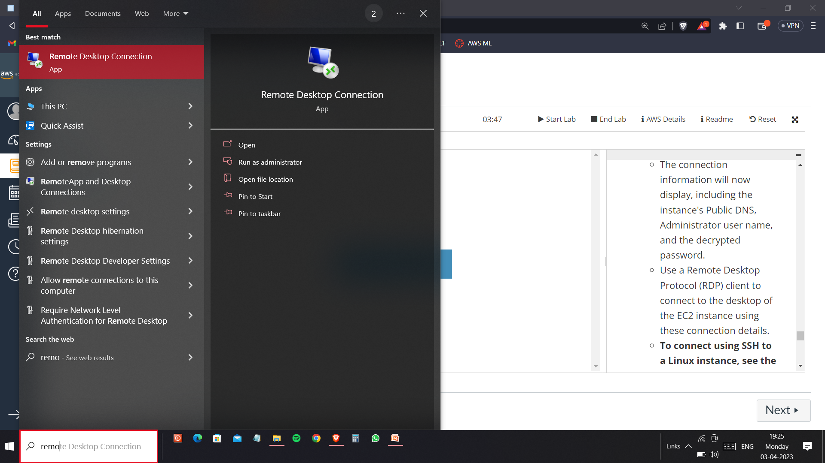
Open the Remote Desktop Connection App in your PC.

Slide 9
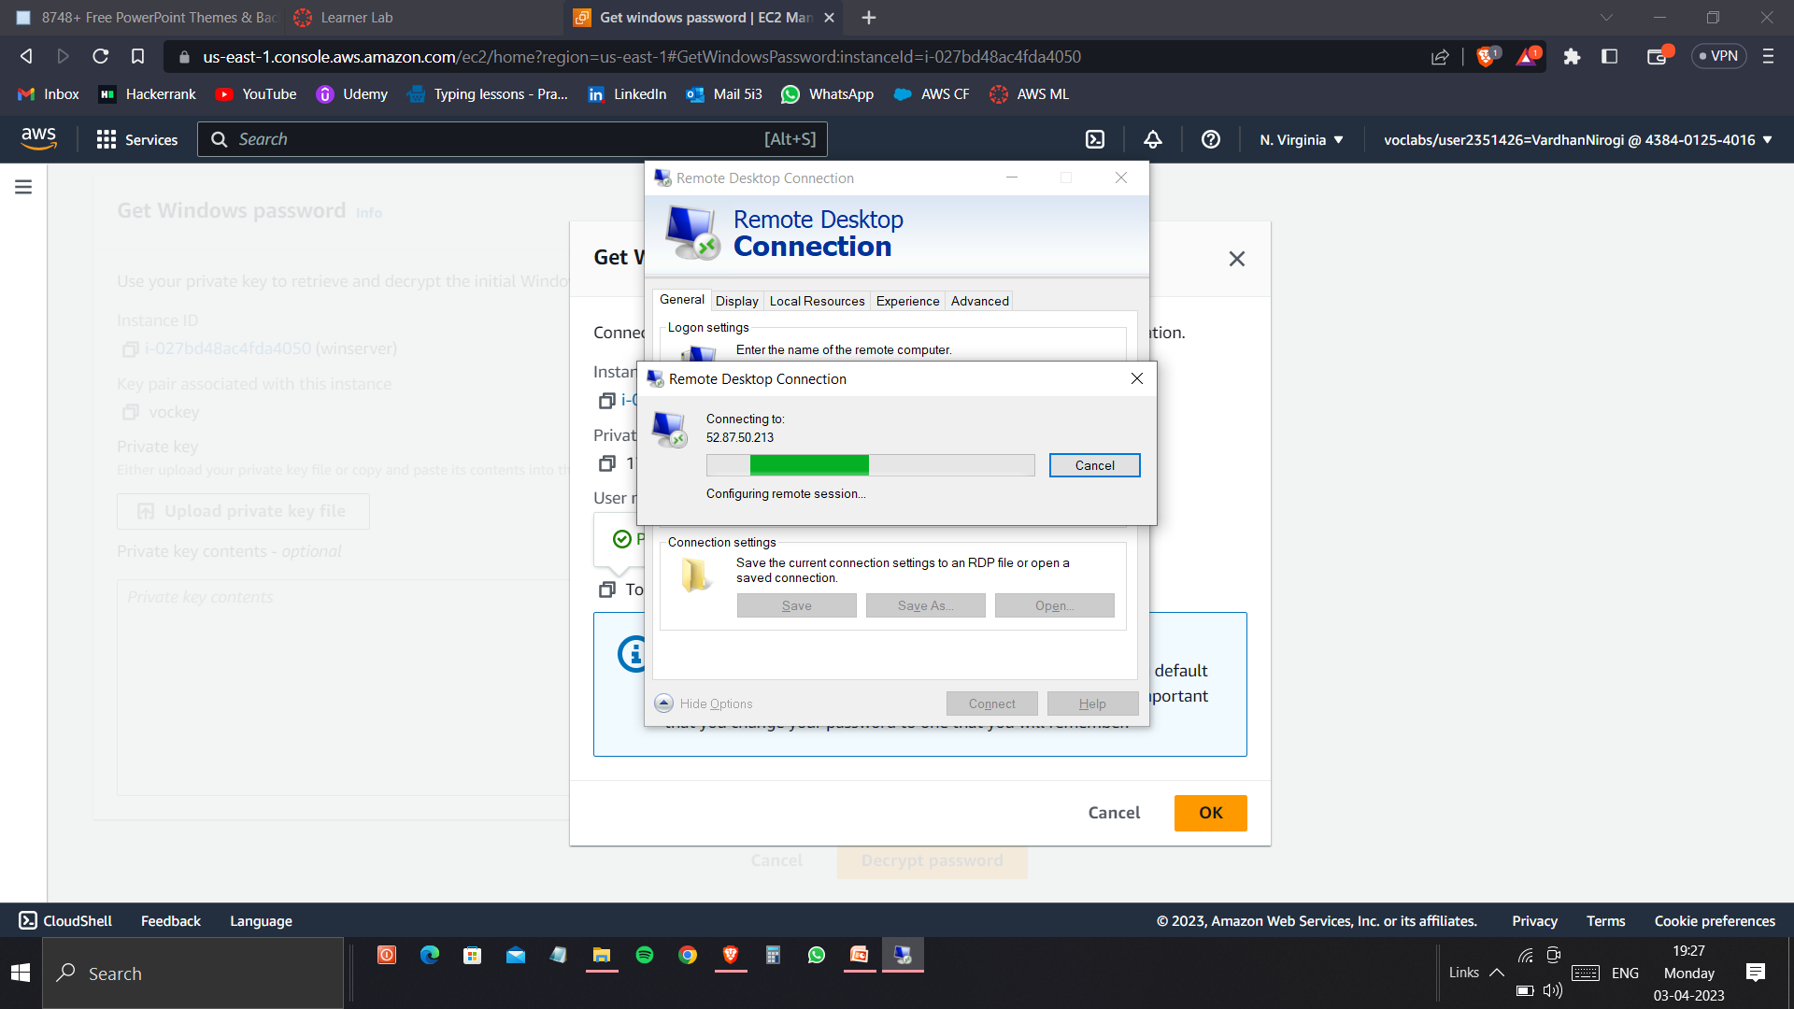
Enter IPv4 Address as Computer you want to login. Then enter username as Administrator and password.

Slide 10
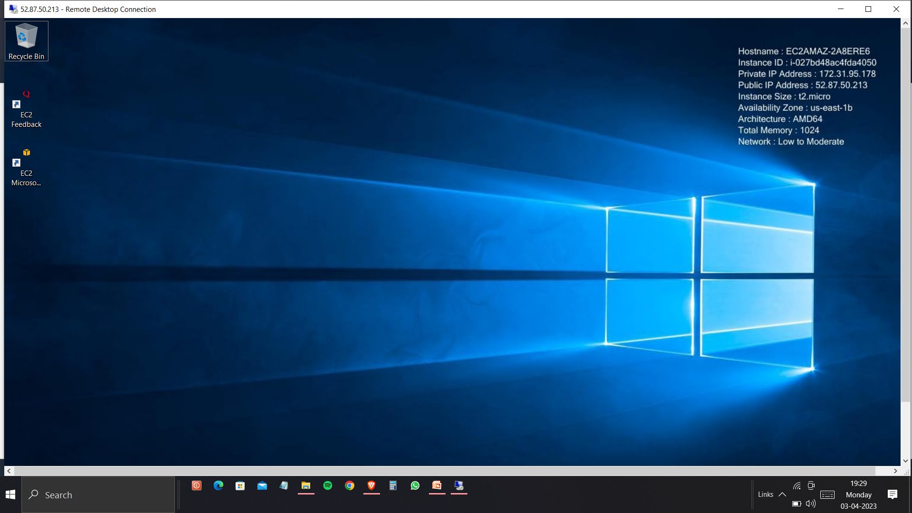
Click Connect and then you will be accessing the Windows EC2 instance in your own system.

Slide 11
Section 2
Creating an alarm in AWS Cloud Watch Service which alerts while exceeding the threshold value

Slide 12
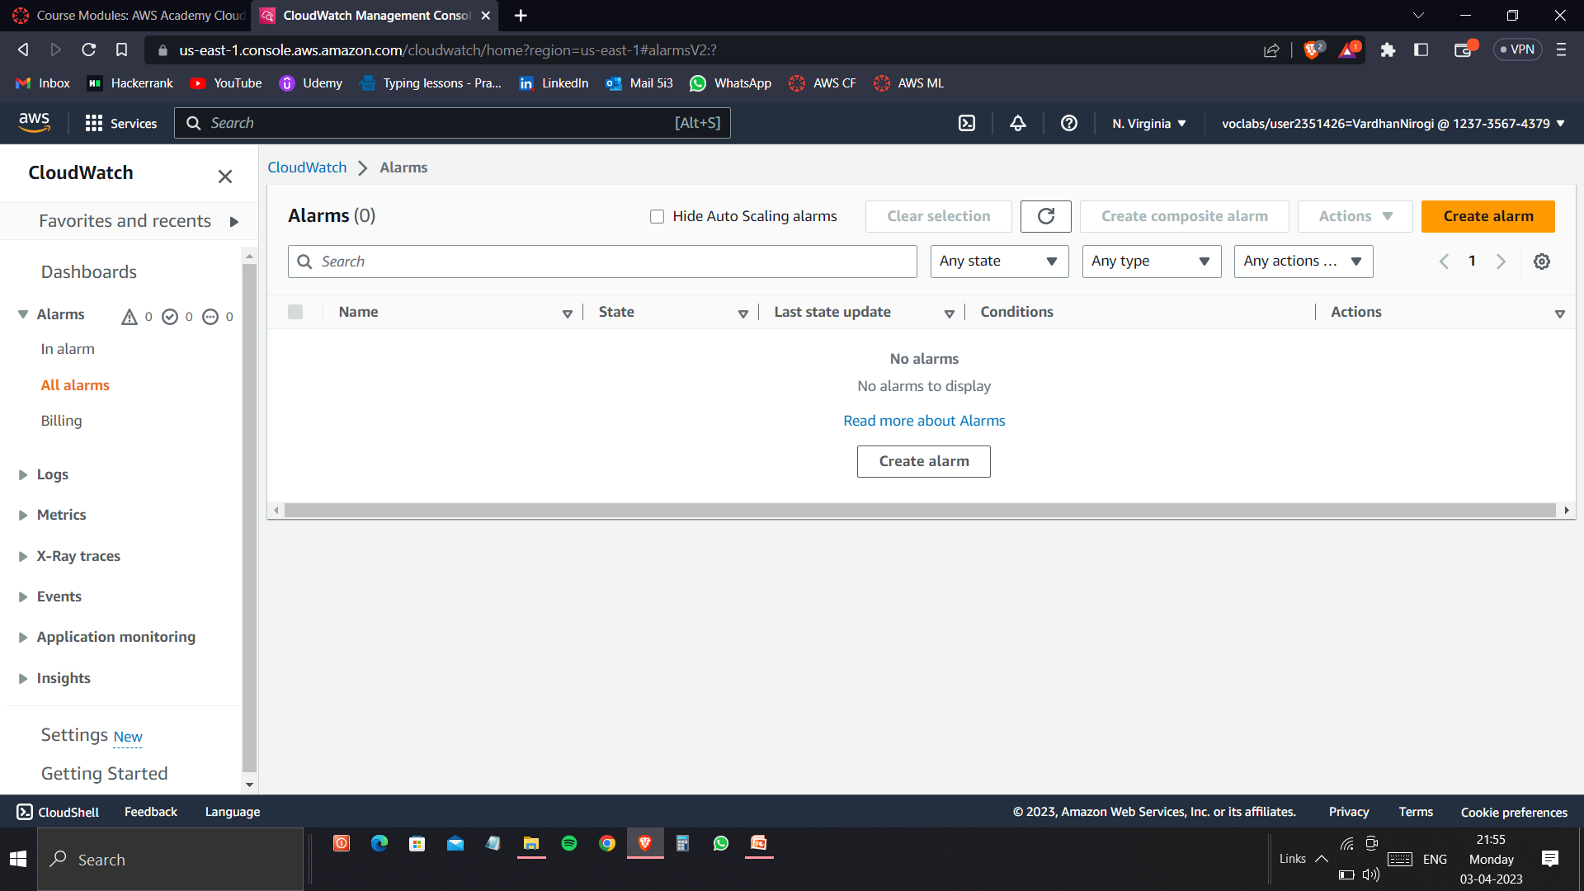
Go to alarm section in AWS CloudWatch

Slide 13
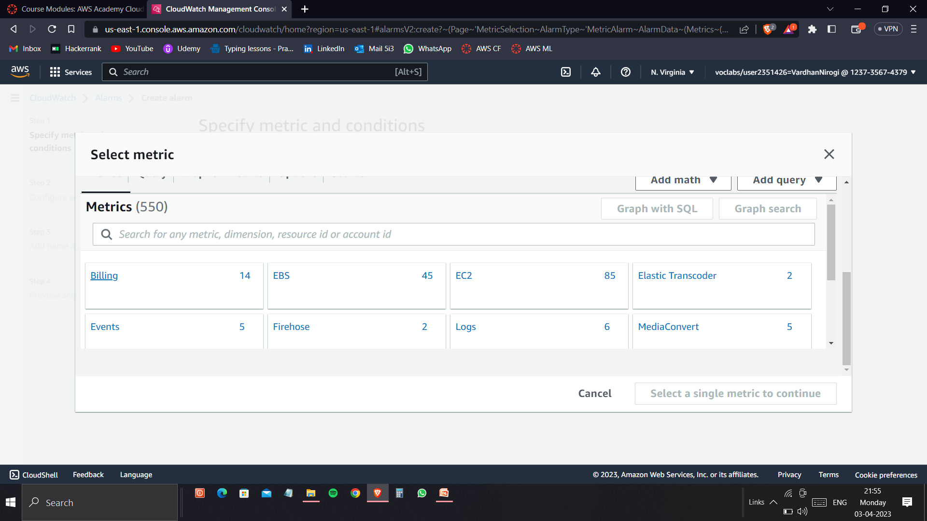
Selecting the billing metric in the Select Metric Section.

Slide 14
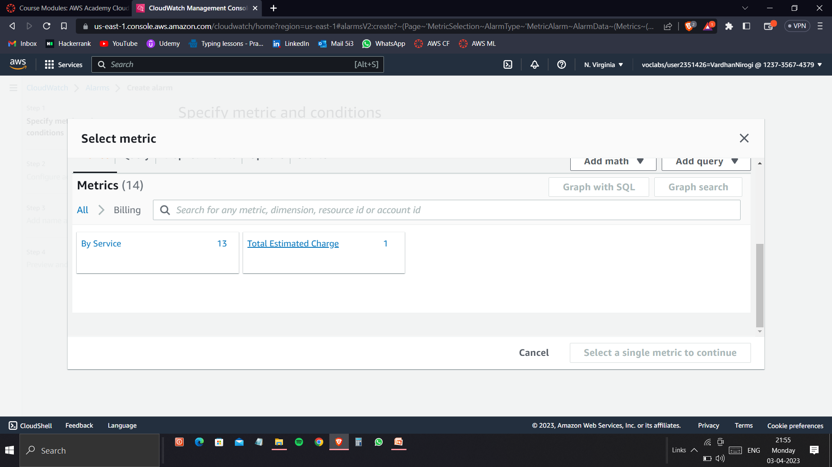
Click the Total Estimated Charge in the single metric of billing section.

Slide 15
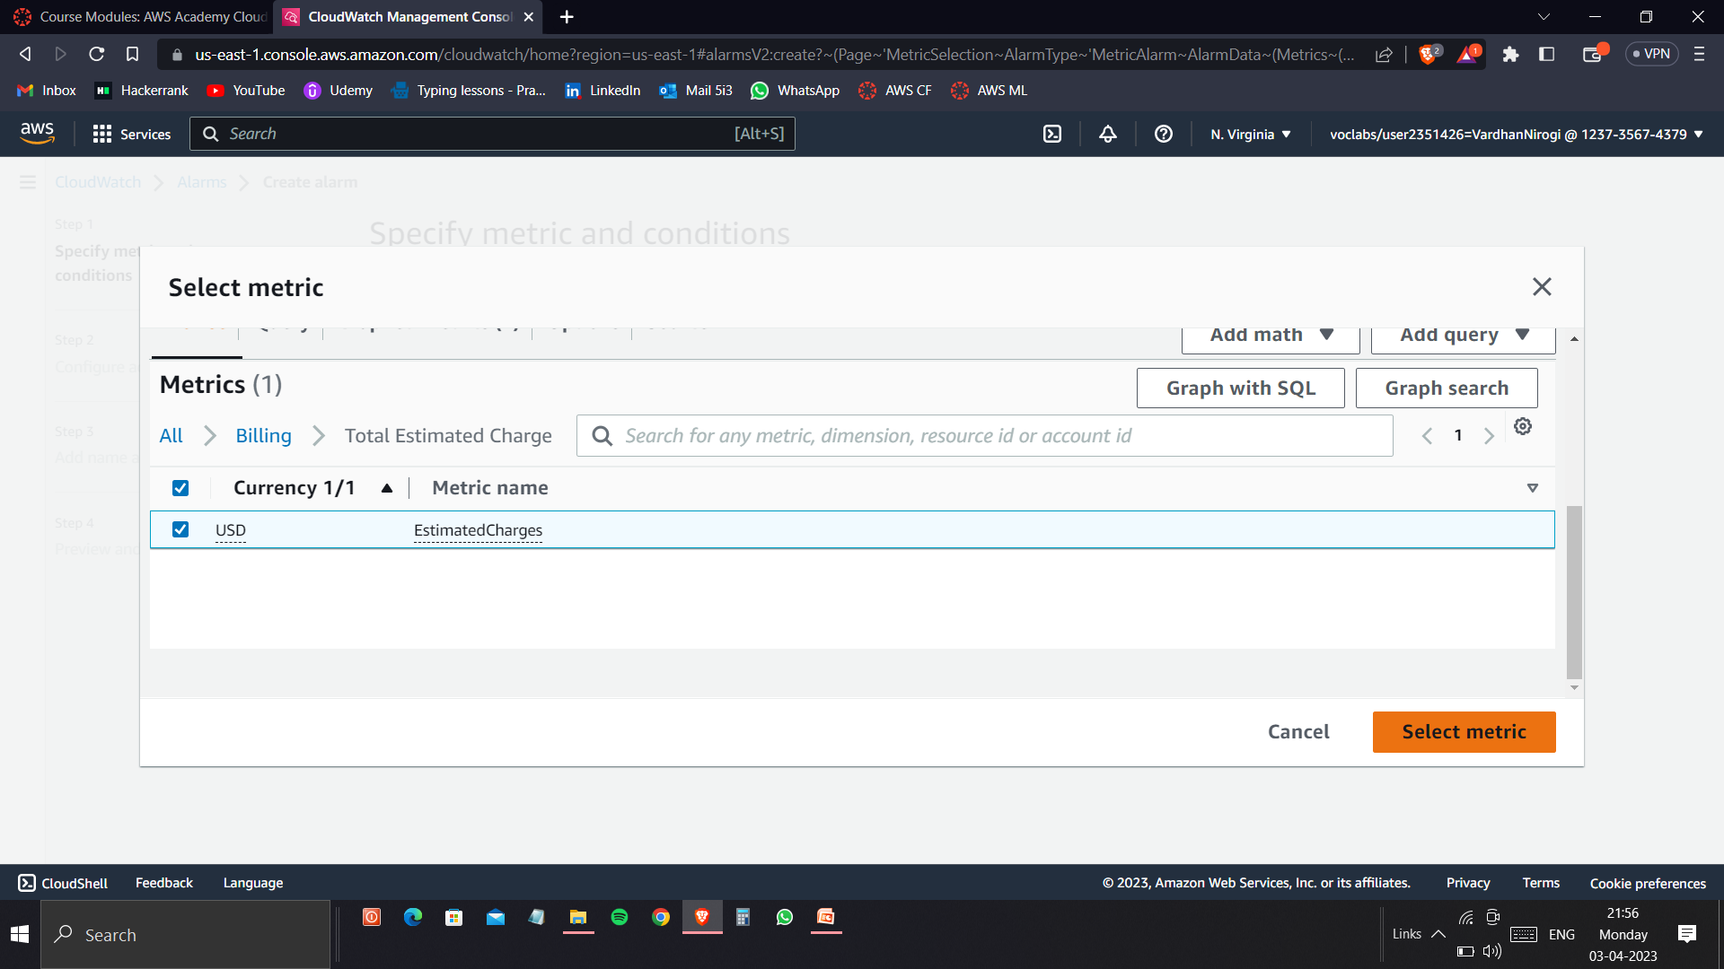
Select the USD Estimated Charges and click on Select Metric.

Slide 16
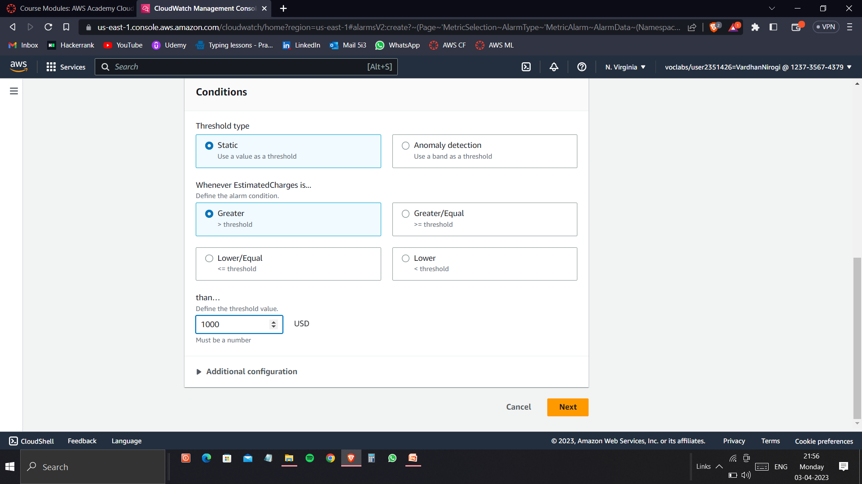
Enter the required threshold value to get an alarm when it exceeds the specified value.

Slide 17
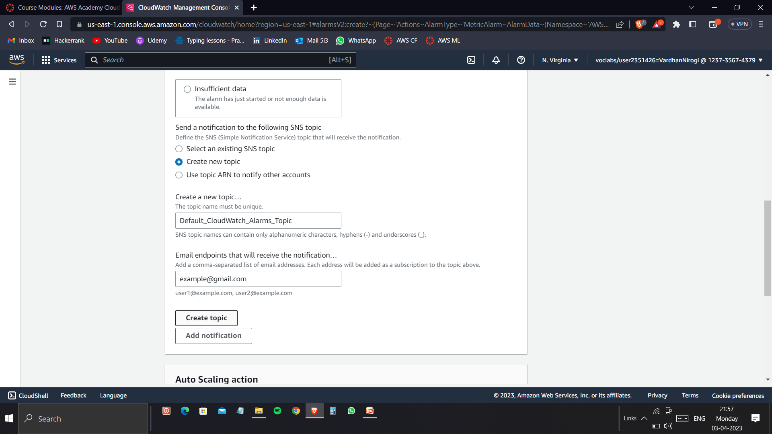
Create a new topic which sends a notification to the specified Email.

Slide 18
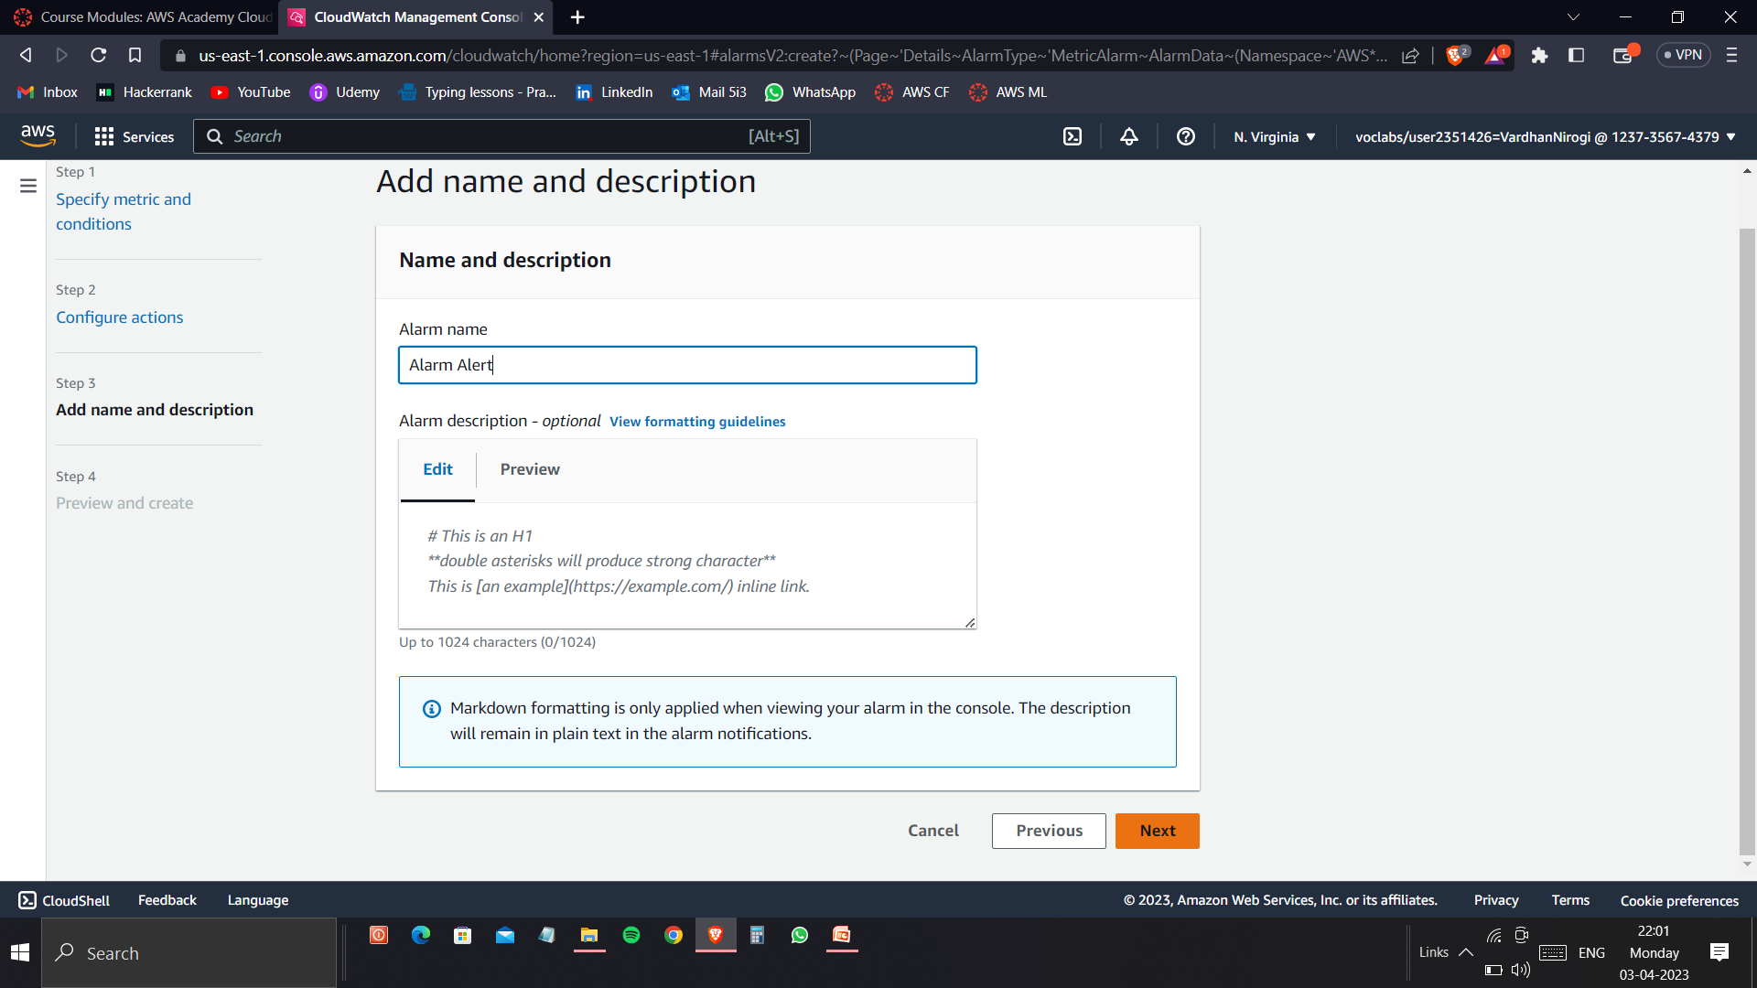
Now create an Alarm name which is used while adding it an AWS Service.

Slide 19
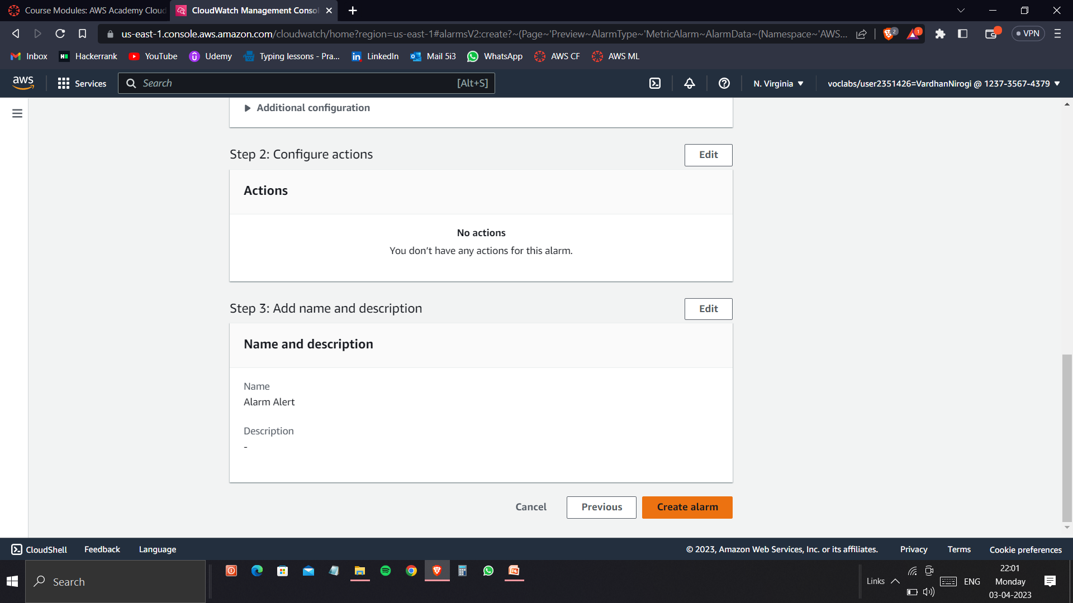
Now click on Create Alarm and add it to the required AWS Service.

